Slide 1
SUMMER INTERNSHIP Presentation
Area of Online Internship | AI/Machine/Deep Learning
Intern Name | Anupam Baranwal
Name Of Institution | INDIAN INSTITUTE OF TECHNOLOGY, INDORE
Faculty Mentor Name | Prof. Vimal Bhatia
Duration | 2 Months (10/05/2021 TO 10/07/2021)
Date Of Submission | 01/07/2021

Slide 2
Topics of Contents
Introduction on CNN
CNN layers
CNN model using GSTRB dataset
Dataset
Data Augmentation
Model
Training model
Conclusion
References

Slide 3
Introduction on CNN
Machine learning has found a variety of applications in multiple fields and become very widespread in research. Among the different ML algorithms, deep learning is very commonly employed in these applications [1].
Convolutional neural network (CNN) is one of the most popular and used of DL networks. The main advantage of CNN compared to its predecessors is that it automatically detects the significant features.
The main benefit of CNN is that it automatically identifies the relevant features without any human supervision. The structure of CNN was inspired by neurons in human and animal brains.[2]
A commonly used type of CNN, which is similar to the multi-layer perceptron (MLP), consists of numerous convolution layers preceding sub-sampling (pooling) layers, while the ending layers are FC layers.

Slide 4
The input x of each layer in a CNN model is organized in three dimensions: height, width, and depth. The depth is also referred to as the channel number.
In addition, the kernels are the basis of the local connections, which share similar parameters for generating k feature maps h^{k} and are convolved with input.
The convolution layer calculates a dot product between its input and the weights as in Eq. 1, but the inputs are undersized areas of the initial image size. Next, by applying the nonlinearity or an activation function to the convolution-layer output.
h^{k} = f( W^{k} ∗ x+ b^{k}) (1)

Slide 5
Benefits of employing CNNs
1. The main reason to consider CNN is the weight sharing feature, which reduces the number of trainable network parameters and in turn helps the network to enhance generalization and to avoid overfitting.
2. Concurrently learning the feature extraction layers and the classification layer causes the model output to be both highly organized and highly reliant on the extracted features.
3. Large-scale network implementation is much easier with CNN than with other neural networks.

Slide 6
CNN layers
The CNN architecture consists of a number of layers.[3]
1. Convolutional Layer
2. Pooling Layer
3. Activation Function
4. Fully Connected Layer
5. Loss Functions

Slide 7
Improving performance of CNN
Based on our experiments in different DL applications . It can be conclude the most active solutions that may improve the performance of CNN are[3]:
●Expand the dataset with data augmentation or use transfer learning (explained in latter sections).
●Increase the training time.
●Increase the depth (or width) of the model.
●Add regularization.
●Increase hyperparameters tuning.

Slide 8
CNN model using GSTRB dataset
The GTSRB - German Trafﬁc Sign Recognition Benchmark dataset is used. The GTSRB has the following properties:
●Single-image, multi-class classiﬁcation problem;
●43 classes;
●Reliable ground-truth data due to semi automatic annotation;
●Physical trafﬁc sign instances are unique within the dataset.

Slide 9
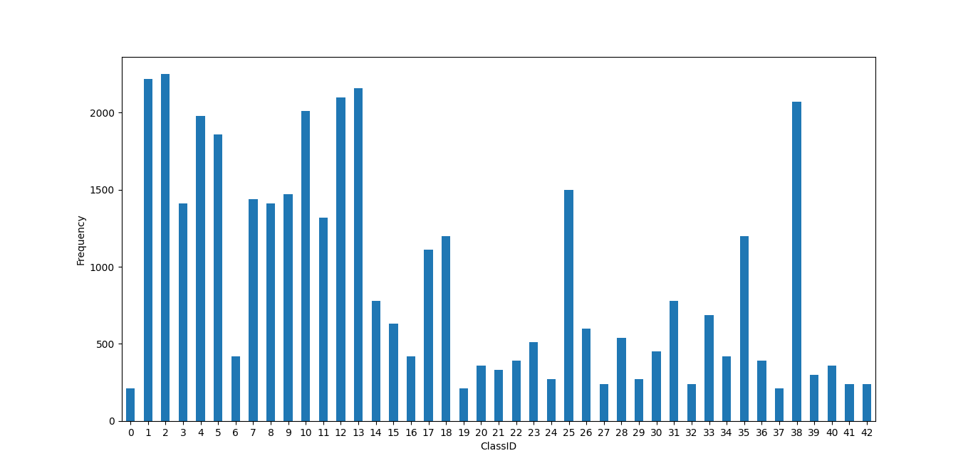
Data Augmentation
The dataset is highly unbalanced.
So, in order to obtain a better training, data augmentation is applied.
Fig 1 – Dataset Distribution

Slide 10
Histogram.py-
import pandas as pd
import matplotlib.pyplot as plt
import os
dataset = pd.DataFrame(columns=['ClassID', 'Frequency'])
paths = os.listdir("gtsrb-german-traffic-sign/Train")
count = 0
for path in paths:
dataset.loc[count] = [int(path), len(os.listdir("gtsrb-german-traffic-sign/Train"+"/"+path))]
count+=1
dat = dataset.sort_values(by=['ClassID'])
dat.plot(x='ClassID', y='Frequency', figsize=(12, 6), kind='bar', legend=False)
plt.xticks(rotation=0)
plt.xlabel("ClassID")
plt.ylabel("Frequency")
plt.show()

Slide 11
ﬂip: This function, flips images of a class horizontally and/or vertically without changing their meaning. Horizontal flip - [11, 12, 13, 15, 17, 18, 22, 26, 30, 35] Vertical flip - [1, 5, 12, 15, 17]
Flip.py
import numpy as np
def flip(X, y):
flip_horizontally = np.array([11, 12, 13, 15, 17, 18, 22, 26, 30, 35])
flip_vertically = np.array([1, 5, 12, 15, 17])
if(y in flip_horizontally):
X = np.fliplr(X)
elif(y in flip_vertically):
X = np.flipud(X)
return X

Slide 12
brightness: apply a random changing brightness to the image
brightness.py
from skimage.exposure import adjust_gamma
import random
def brightness(X, intensity=0.5):
delta = 1. * intensity
X = adjust_gamma(X, random.uniform(1 - delta, 1 + delta))
return X

Slide 13
rotate_image: apply a random rotation to the image
rotate_image.py
from skimage.transform import rotate
import random
def rotate_image(X, intensity=0.5):
delta = 30. * intensity
X = rotate(X, random.uniform(-delta, delta))
return X

Slide 14
projection_transform: apply a random perspective transformation of the signal
def projection_transform(X, intensity=0.5):
image_size = X.shape[1]
d = image_size * 0.3 * intensity tl_top = random.uniform(-d, d)
tl_left = random.uniform(-d, d)
bl_bottom = random.uniform(-d, d)
bl_left = random.uniform(-d, d)
tr_top = random.uniform(-d, d)
tr_right = random.uniform(-d, d)
br_bottom = random.uniform(-d, d)
br_right = random.uniform(-d, d) transform = ProjectiveTransform()
transform.estimate(np.array((
(tl_left, tl_top),
(bl_left, image_size - bl_bottom),
(image_size - br_right, image_size - br_bottom),
(image_size - tr_right, tr_top)
)), np.array(((0, 0),(0, image_size),(image_size, image_size),(image_size, 0)))) X = warp(X, transform, output_shape=(image_size, image_size), order = 1, mode = 'edge')

Slide 15
noise: applies gaussian noise to the image. Gaussian noise, which has zero mean, essentially has data points in all frequencies, effectively distorting the high frequency features.
Noise.py
import cv2
import numpy as np
from skimage.util import random_noise
def noise(X):
X = random_noise(X, mode='gaussian',mean=0.0)
return X

Slide 16
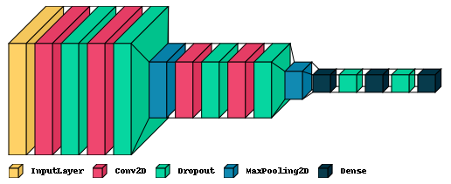
CNN Model
The model is trained with the augmented and balanced dataset, setting the number of epochs equals to 100. The model reaches very fast a very high accuracy for both train and validation, with 93.71 accuracy.
To avoid to re-train the model at every execution of the attacks, and even to charge every time the whole trained model, once the model is obtained its weights are saved in a .hdf5 file format.
Fig 2 – Layers of model

Slide 17
Input layer: Built an input layer to avoid having uniform images to give as input for our model. In order to do this, I passed to the model an (32, 32, 3) shape.
Coevolutionary layers: Used 2 convolutional layers, using 32, 64 ﬁlters, respectively, with a kernel size of 5x5. These layers create a convolution kernel that is convolved with the layer input to produce a tensor of outputs. Each convolutional layer is followed by a ReLU activation function.

Slide 18
Dropout layers: This layer randomly dropping out (setting to zero) a number of output features of the layer during training. This is very useful to prevent overﬁtting.
Pooling layers: These layers help the model to remove un-useful information, this is needed because, very often, neighbouring elements contain very similar information.

Slide 19
call_model.py
train_datagen = ImageDataGenerator(rescale=1./255,validation_split=0.3)
train_generator = train_datagen.flow_from_directory(
"train_augmented",
target_size=(32, 32),
batch_size=32,
class_mode='categorical',
subset='training',
shuffle=True,
seed=42)
validation_generator = train_datagen.flow_from_directory(
"train_augmented",
target_size=(32, 32),
batch_size=32,
class_mode='categorical',
subset='validation',
shuffle=True,
seed=42)
tmp = pd.DataFrame(columns=['ClassId', 'ModelId', 'SignName'])
csv_data = pd.read_csv("sign_name.csv")

Slide 20
for i, item in csv_data.iterrows():
tmp.loc[i] = [item['ClassId'], train_generator.class_indices[str(item['ClassId'])], item['SignName’]]
tmp.to_csv("sign_name.csv", sep=',', index = False)
model = build_cnn((32, 32, 3))
steps_per_epoch=train_generator.n//train_generator.batch_size
val_steps=validation_generator.n//validation_generator.batch_size+1
modelCheckpoint = ModelCheckpoint("models/weights_cnn.hdf5", monitor='val_loss', verbose=1, save_best_only=True, save_weights_only=False, mode='auto', period=1)
earlyStop = EarlyStopping(monitor='val_loss', min_delta=0.001, patience=6, verbose=0, mode='auto')
callbacks_list = [modelCheckpoint, earlyStop]
history = model.fit_generator(
train_generator,
workers=6,
epochs=100,
verbose=1,
steps_per_epoch=steps_per_epoch,
validation_steps=val_steps,
validation_data=validation_generator,
callbacks=callbacks_list,
shuffle=True)

Slide 21
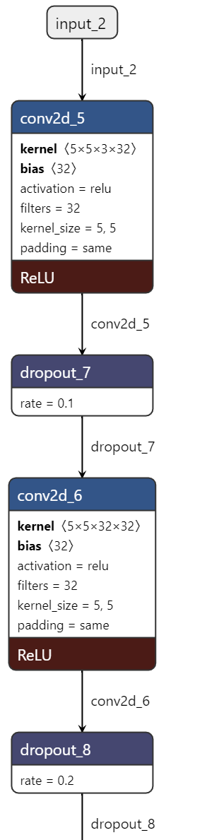
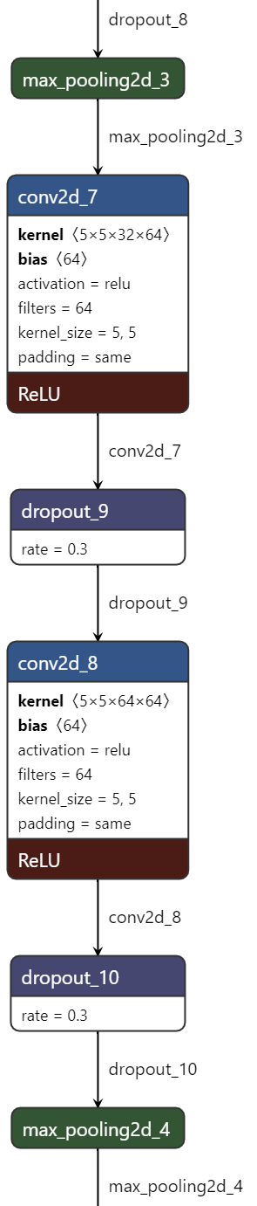
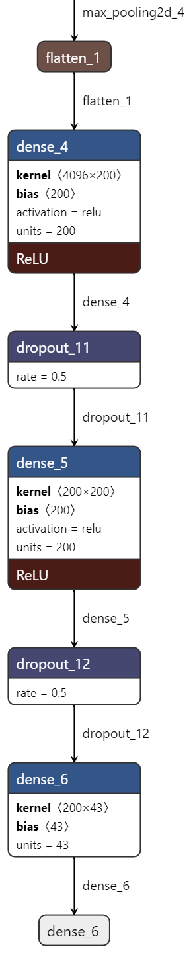
Fig 3 – Architecture of model

Slide 22
train.py
train_datagen = ImageDataGenerator(rescale=1./255,validation_split=0.3)
train_generator = train_datagen.flow_from_directory("train_augmented",
target_size=(32, 32),batch_size=32,
class_mode='categorical',
subset='training',
shuffle=True,
seed=42)
validation_generator = train_datagen.flow_from_directory("train_augmented",
target_size=(32, 32),batch_size=32,
class_mode='categorical',
subset='validation',
shuffle=True,
seed=42)
tmp = pd.DataFrame(columns=['ClassId', 'ModelId', 'SignName'])
csv_data = pd.read_csv("sign_name.csv")
for i, item in csv_data.iterrows():
tmp.loc[i] = [item['ClassId'], train_generator.class_indices[str(item['ClassId'])], item['SignName']]
tmp.to_csv("sign_name.csv", sep=',', index = False)
model = build_cnn((32, 32, 3))

Slide 23
callbacks_list = [modelCheckpoint, earlyStop]
history = model.fit_generator(train_generator,workers=6,
epochs=100,verbose=1,steps_per_epoch=steps_per_epoch,
validation_steps=val_steps,validation_data=validation_generator,
callbacks=callbacks_list,
shuffle=True)
# Plot training & validation accuracy values
plt.plot(history.history['accuracy'])
plt.plot(history.history['val_accuracy'])
plt.title('Model accuracy')
plt.ylabel('Accuracy')
plt.xlabel('Epoch')
plt.legend(['Train', 'Validation'], loc='upper left')
plt.show()
# Plot training & validation loss values
plt.plot(history.history['loss'])
plt.plot(history.history['val_loss'])
plt.title('Model loss')
plt.ylabel('Loss')
plt.xlabel('Epoch')
plt.legend(['Train', 'Validation'], loc='upper left')
plt.show()

Slide 24
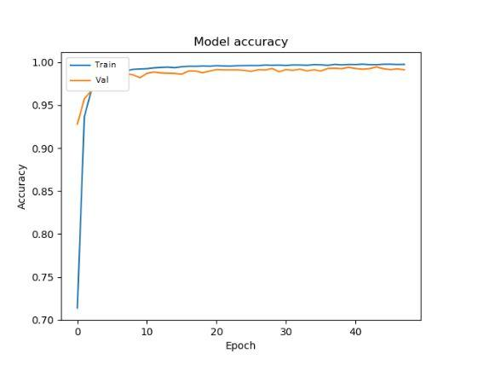
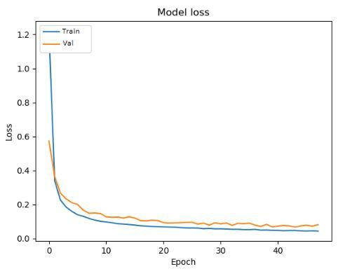
Testing the model
Modal is tested against a test dataset . To execute it, an image data generator is used to process the images and pass them to the model for prediction.
Fig 4 – Accuracy plot
Fig 5 – Loss Plot

Slide 25
test.py
model = load_model_weights("models/weights_cnn.hdf5")
test_datagen = ImageDataGenerator(rescale=1./255)
test_generator = ImageDataGenerator(rescale=1./255).flow_from_directory(
"gtsrb-german-traffic-sign/Testing",
target_size=(32, 32),
batch_size=32,
class_mode=None,
shuffle=False)
val_steps = test_generator.n//test_generator.batch_size+1
preds = model.predict_generator(test_generator, verbose=1, steps=val_steps)
Ypred = np.argmax(preds, axis=1)
dataframe = pd.read_csv("sign_name.csv")
l = []
for i in range(len(Ypred)):
l.append(int(dataframe['ClassId'].loc[dataframe['ModelId'] == Ypred[i]]))
result = np.array(l)

Slide 26
test = pd.read_csv("gtsrb-german-traffic-sign/Test.csv")
count_err = 0
for i, item in test.iterrows():
if (item['ClassId'] != result[i]):
count_err += 1
accuracy = round((float(count_err) / float(len(Ypred))) * 100, 2)
print("Accuracy "+str(accuracy)+"%")
keras.utils.plot_model(
model,
to_file="model.png",
show_shapes=True,
show_dtype=False,
show_layer_names=True,
rankdir="TB",
expand_nested=True
)
visualkeras.layered_view(model, type_ignore=[keras.layers.Flatten], legend=True,to_file='architecture.png')

Slide 27
Conclusion
I have discussed about convolutional neural network (CNN) and different layers used to implement CNN. Also, I implemented a model using GSTRB dataset. Model can predict the class of sign board with accuracy of 93.71%.

Slide 28
References
[1] Liu W, Wang Z, Liu X, Zeng N, Liu Y, Alsaadi FE. A survey of deep neural network architectures and their applications. Neurocomputing.
[2] Potok TE, Schuman C, Young S, Patton R, Spedalieri F, Liu J, Yao KT, Rose G, Chakma G. A study of complex deep learning networks on high-performance, neuromorphic, and quantum computers. ACM J Emerg Technol Comput Syst (JETC).
[3] Gu J, Wang Z, Kuen J, Ma L, Shahroudy A, Shuai B, Liu T, Wang X, Wang G, Cai J, et al. “Recent advances in convolutional neural networks. Pattern Recogn”.
[4] Laith Alzubaidi, Jinglan Zhang, Amjad J. Humaidi, Ayad Al-Dujaili, Ye Duan, Omran Al-Shamma, J. Santamaría, Mohammed A. Fadhel, Muthana Al-Amidie & Laith Farhan, “Review of deep learning: concepts, CNN architectures, challenges, applications, future directions”
[5] Alzubaidi L, Fadhel MA, Al-Shamma O, Zhang J, Duan Y. Deep learning models for classification of red blood cells in microscopy images to aid in sickle cell anemia diagnosis. Electronics.
[6] Chawin Sitawarin,Arjun Nitin Bhagoji,Arsalan Mosenia, Mung Chiang,Prateek Mittal “DARTS: Deceiving Autonomous Cars with Toxic Signs”
[7] Chawin Sitawarin,Arjun Nitin Bhagoji,Arsalan Mosenia, Mung Chiang,Prateek Mittal, Rogue Signs: Deceiving Trafﬁc Sign Recognition with Malicious Ads and Logos

